Slide 1
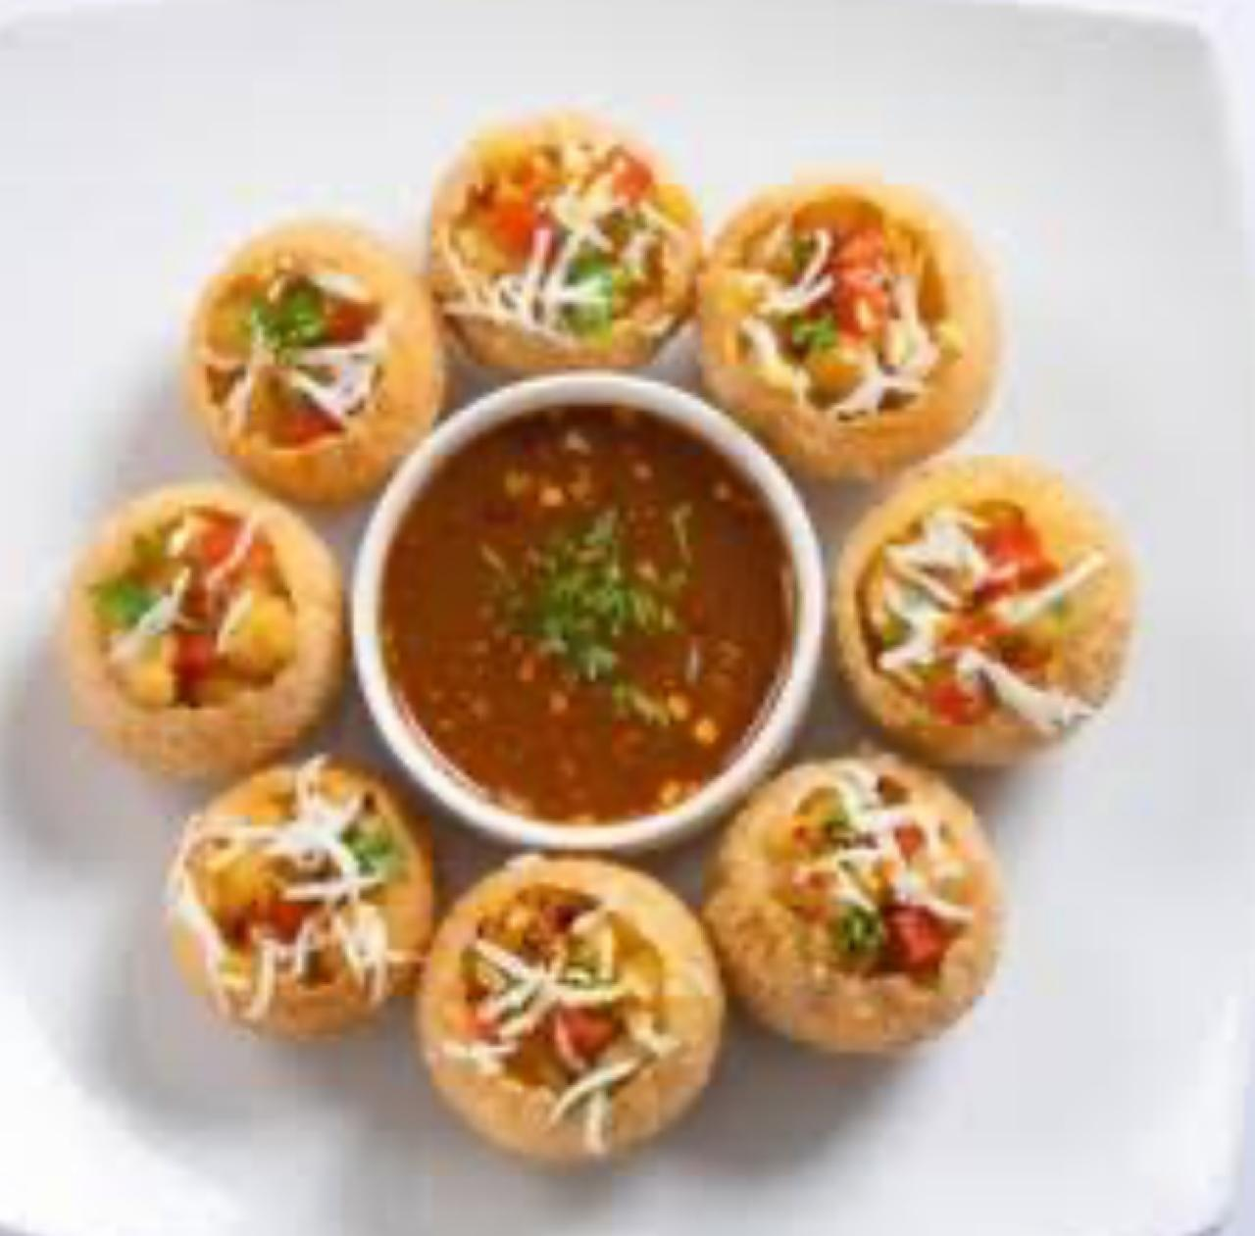
PANI PURI
TEAM-26

Slide 2
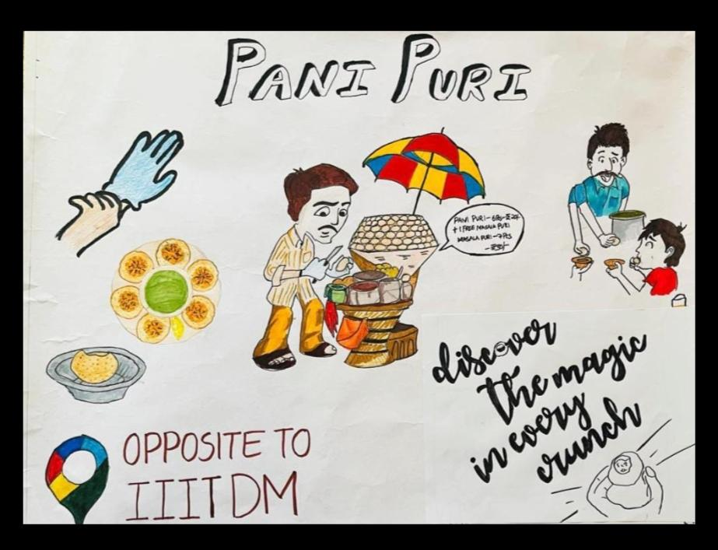

Slide 3
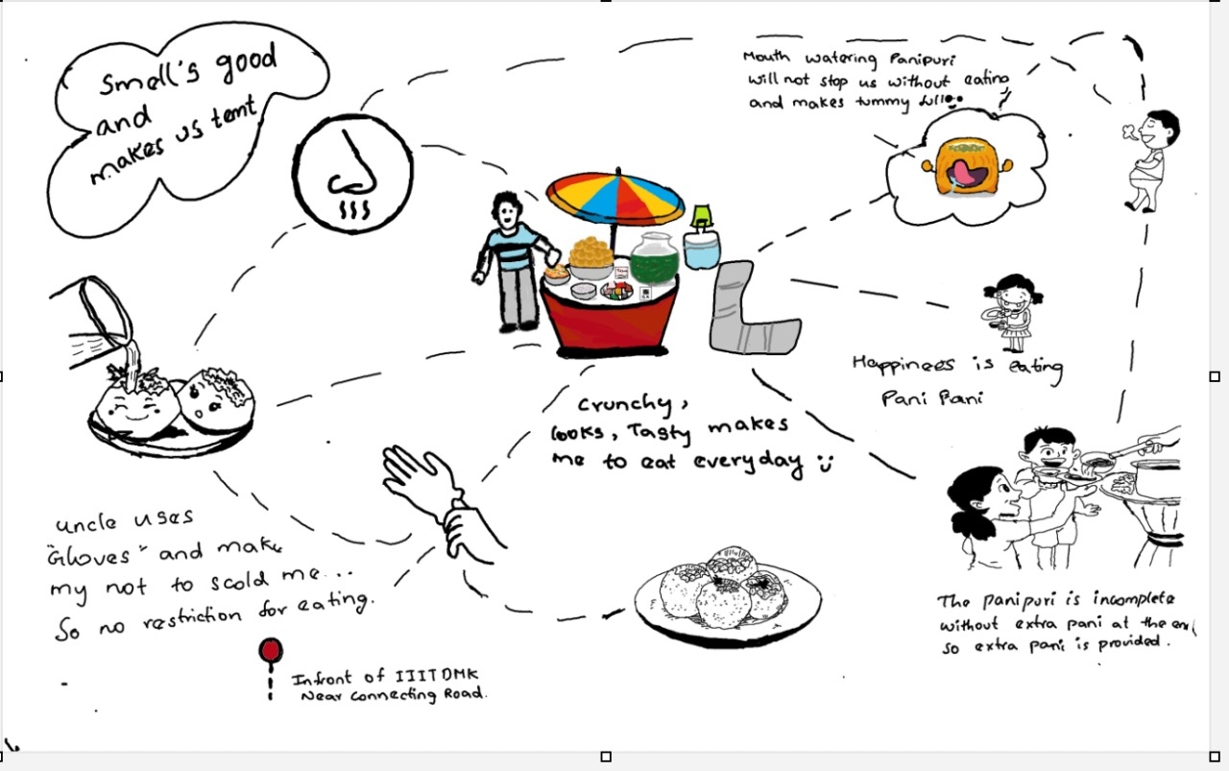
EC23B1102 MADHAMSHETTY SATHVIKA

Slide 4
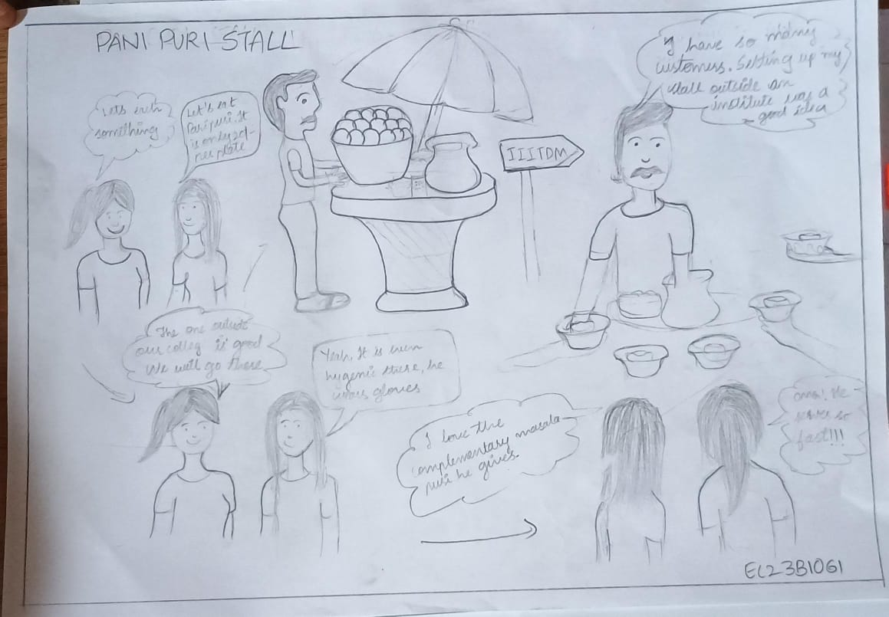
EC23B1061 CHALLA NAGA BHAVISHYA

Slide 5
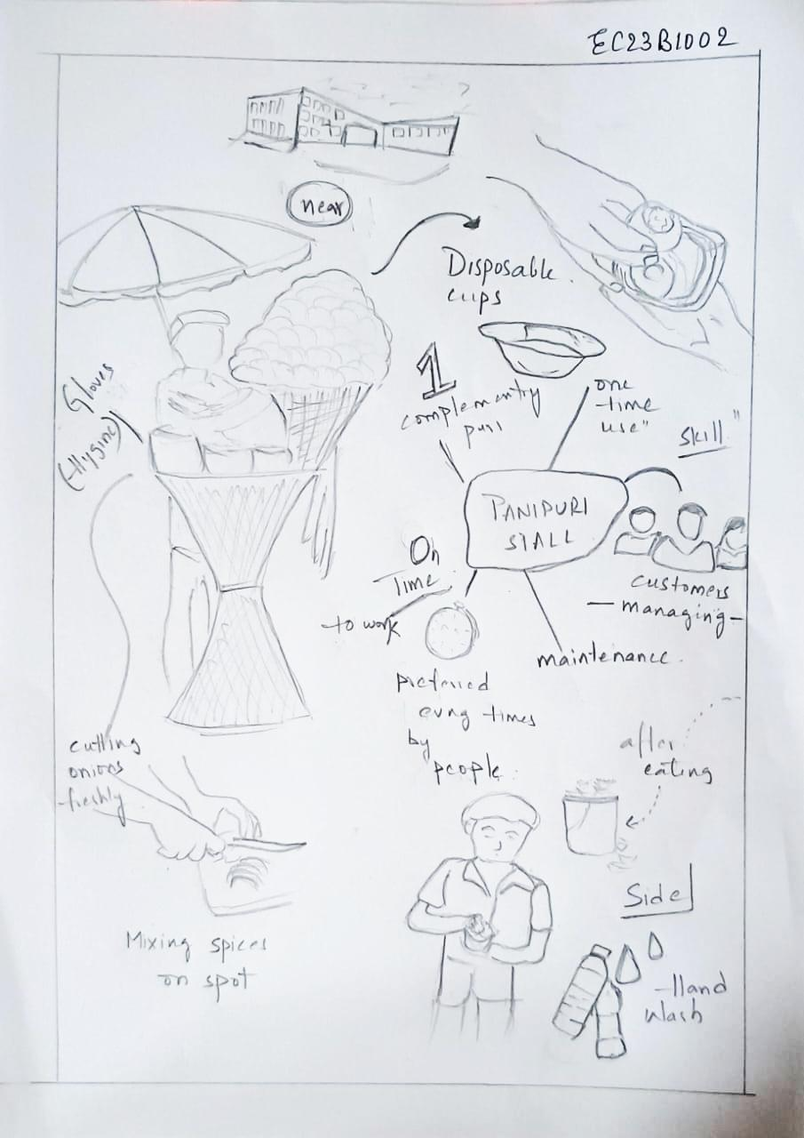
EC23B1002 G Deavi Asritha Srivardhini

Slide 6
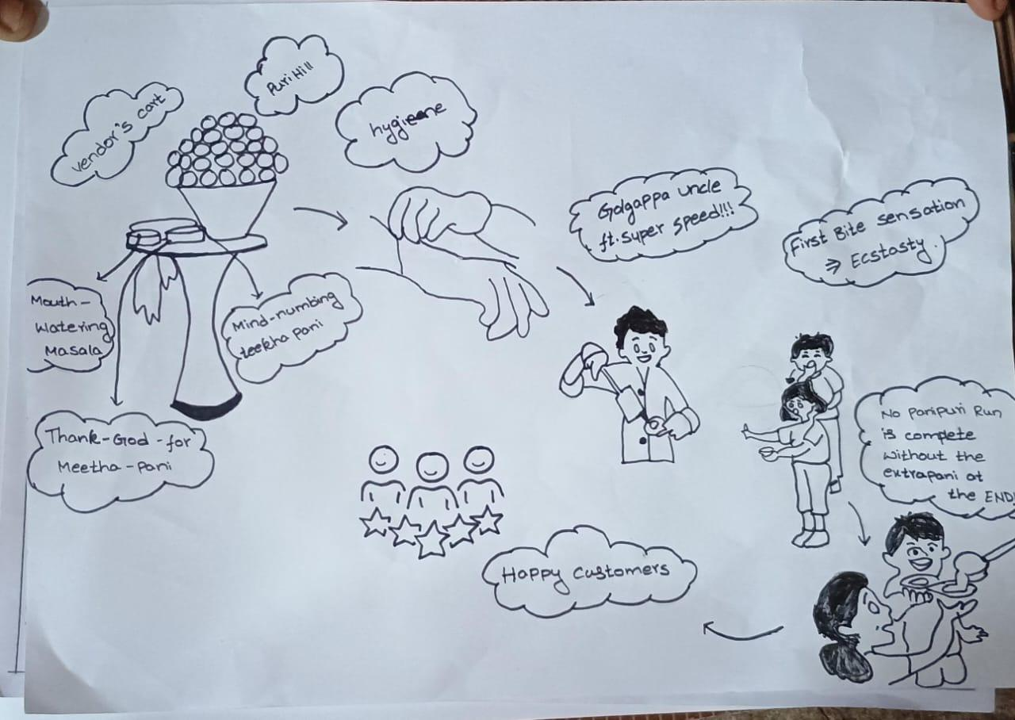
EC23B1014 Ch.Pallavi

Slide 7
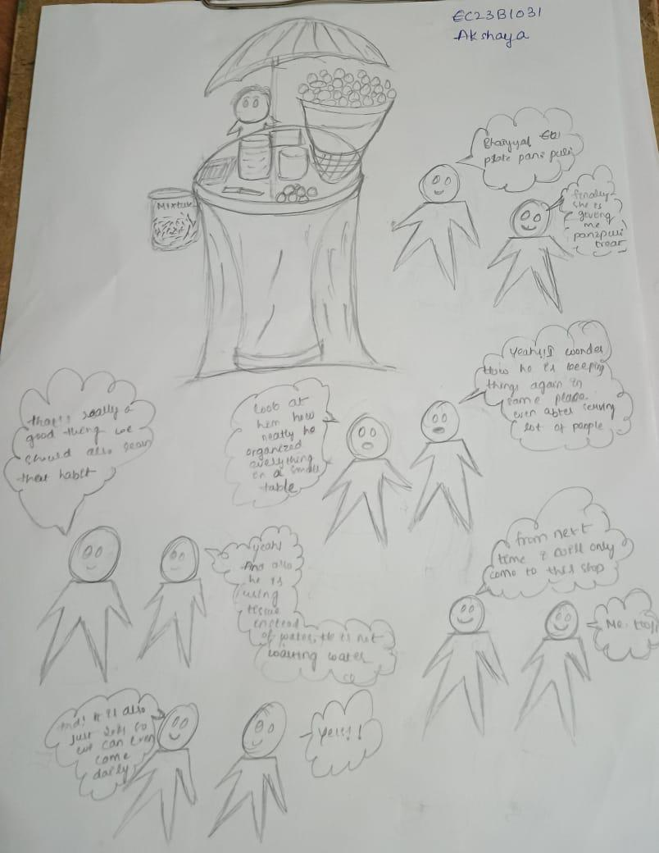
EC23B1031 S Akshaya

Slide 8
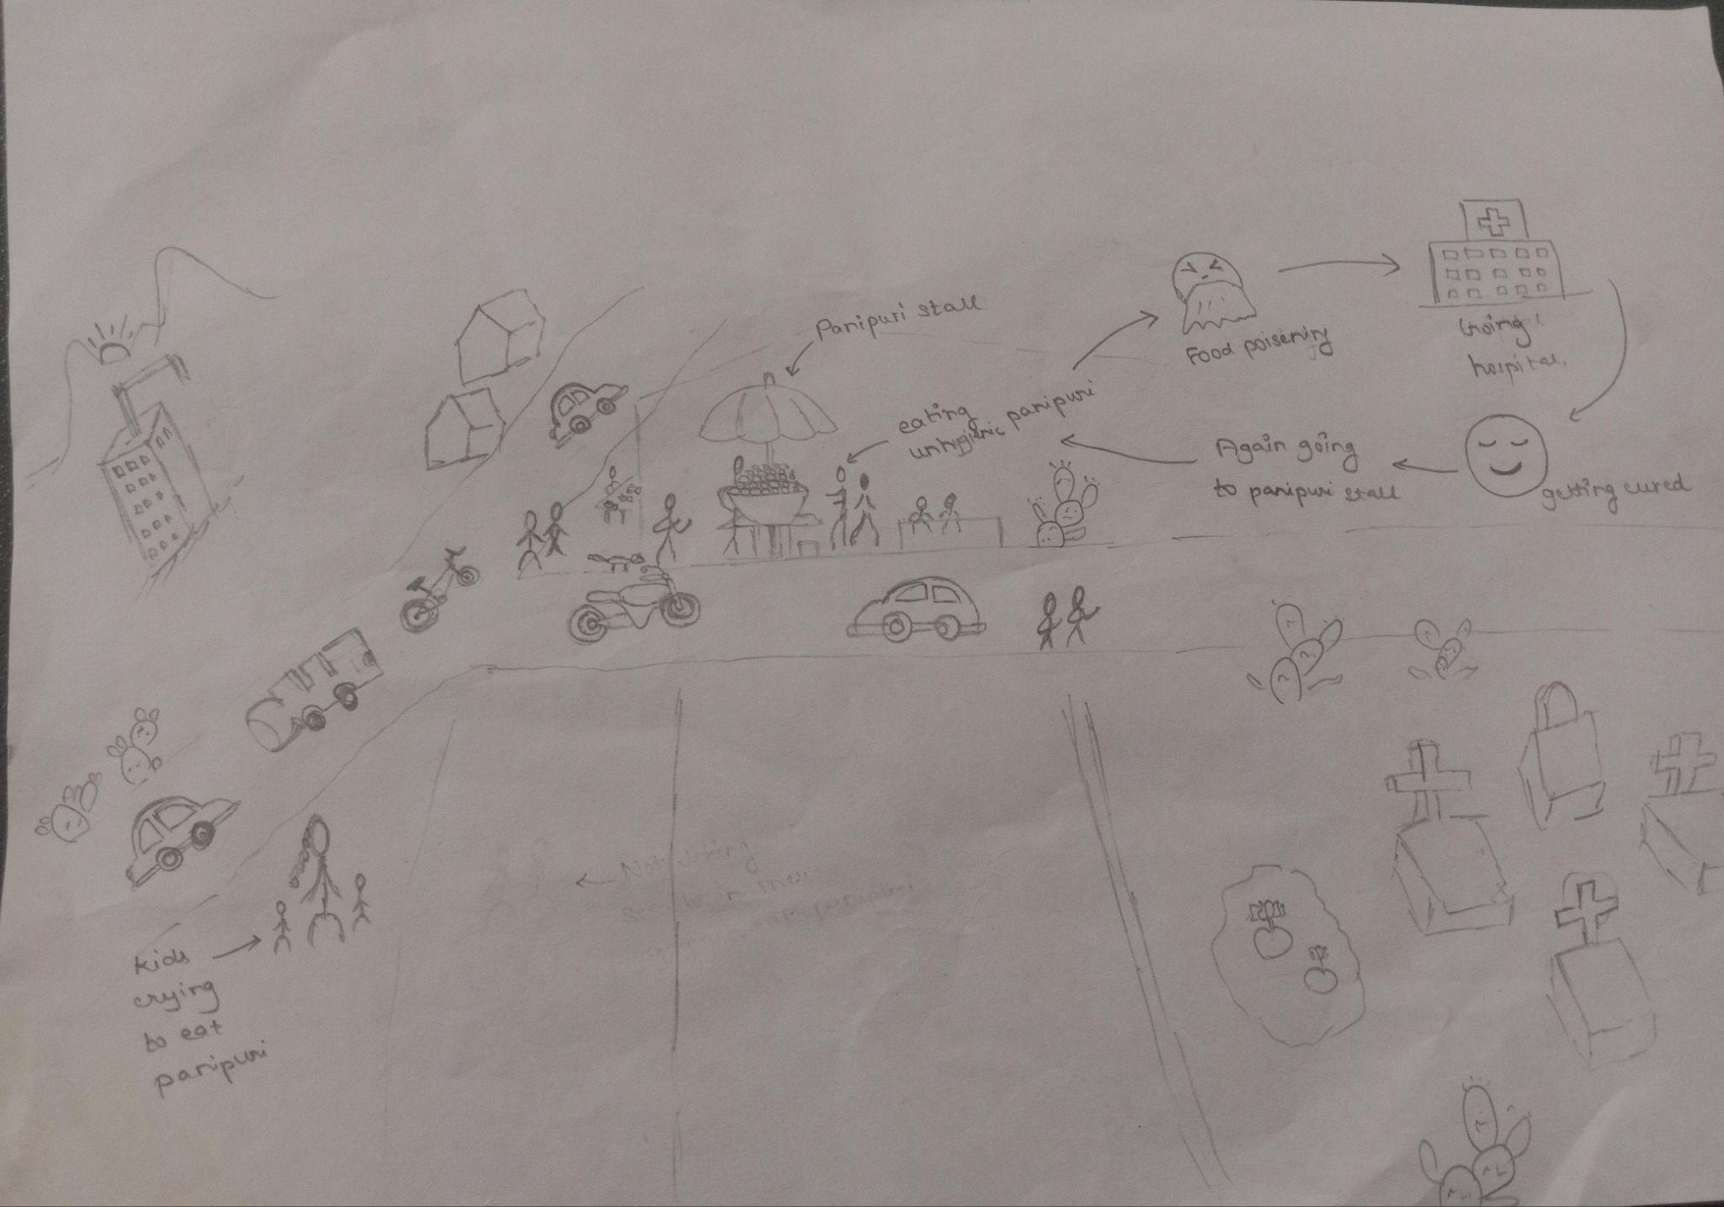
EC23B1120
Rithanya.s

Slide 9
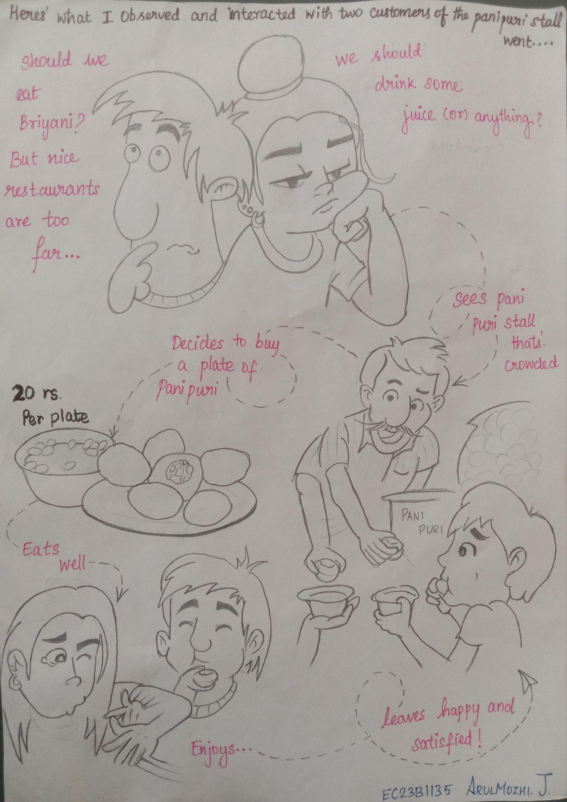
EC23B1135
Arulmozhi.J

Slide 10
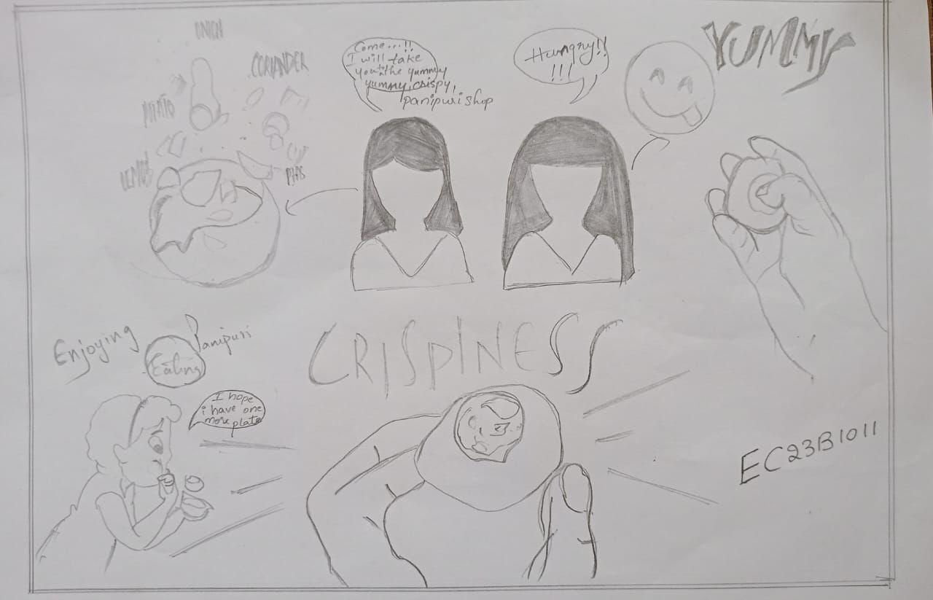
EC23B1011 NUKALA SUPRIYA

Slide 11
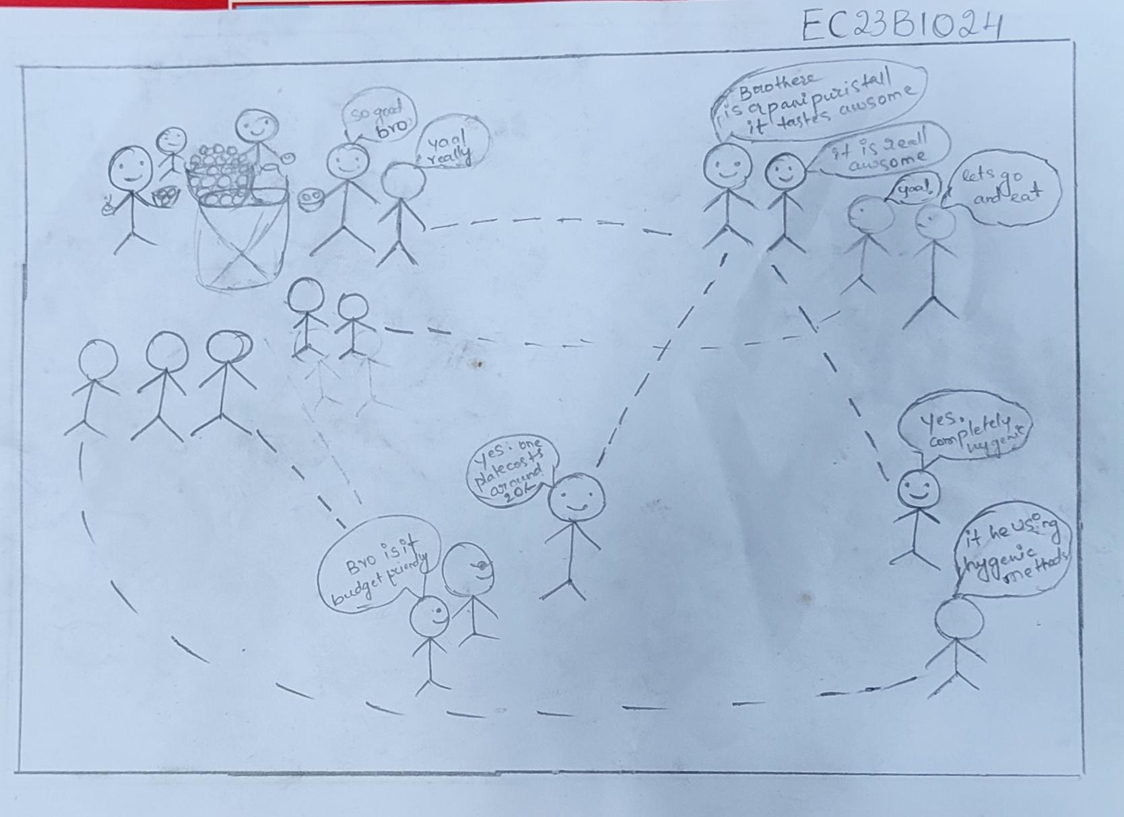
Ec23b1024 Boina Deshik

Slide 12
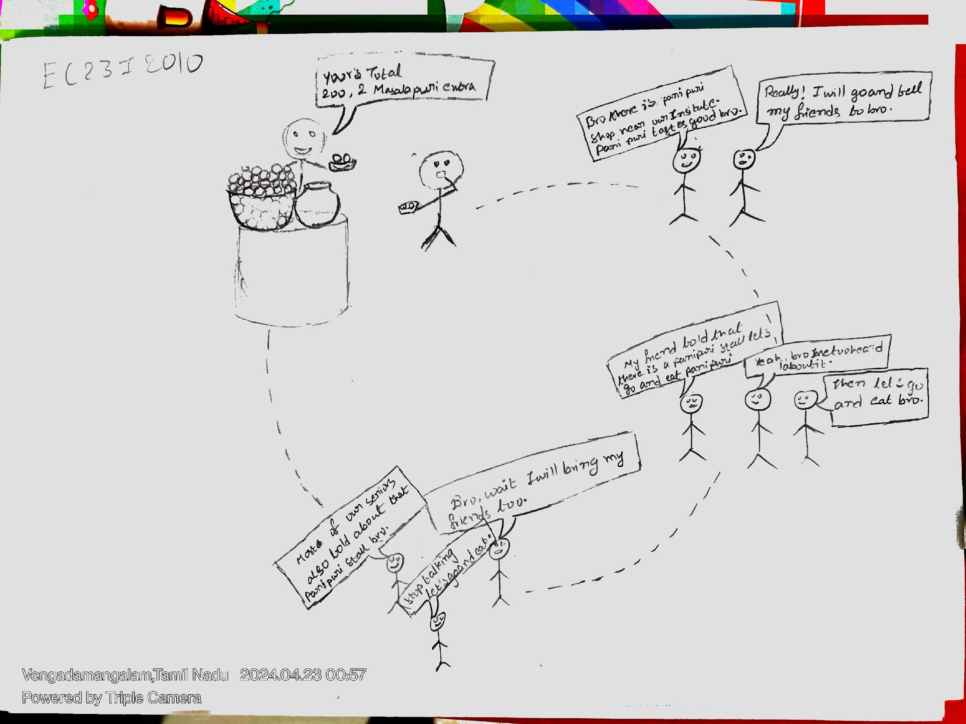
EC23I2010 K V Manish

Slide 13
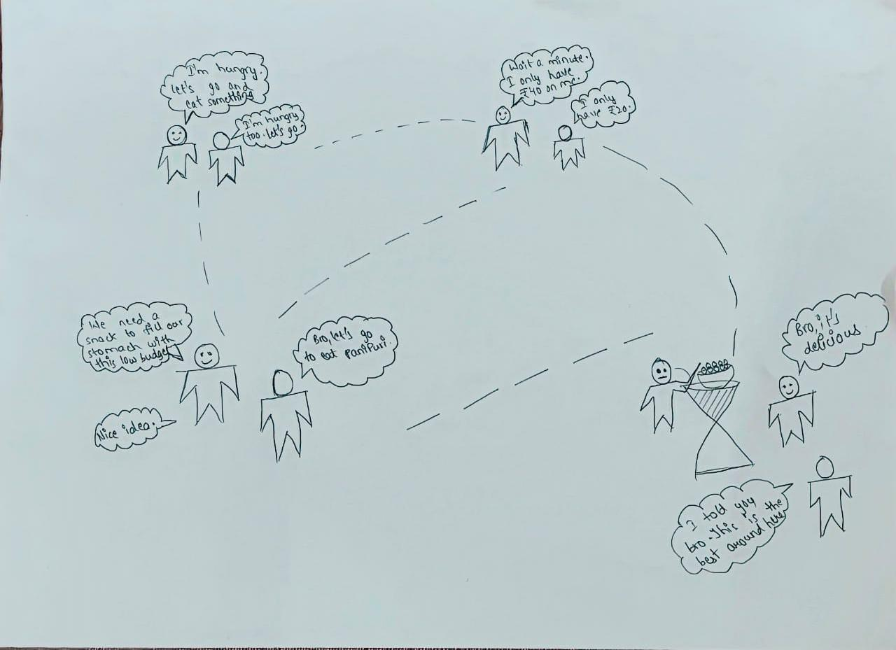
EC23B1127 M Someshwar Raj

Slide 14
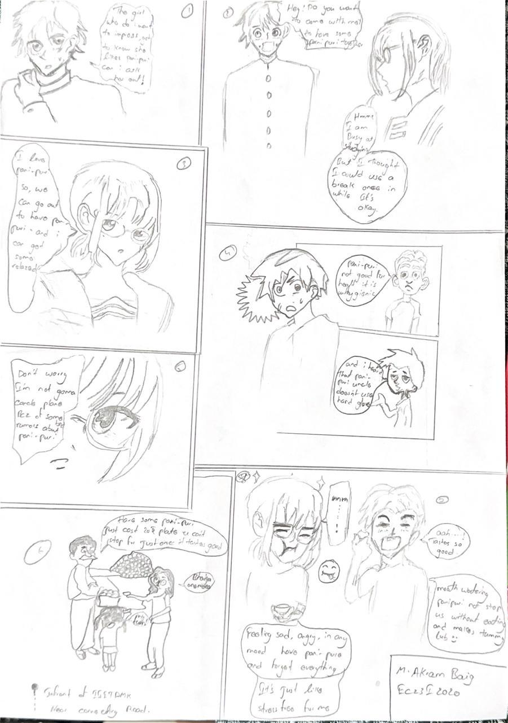
EC23I2020 Mogal Mohammad Akram baig

